Slide 1
Kannada Literature, Malayalam Literature , Sangama Literature Northern Indian Languages & Literature, Persian And Urdu ,Hindi Literature unit 2

Slide 2
Dravidian Literature
This section comprises of literature in four major Dravidian languages: Tamil, Kannada, Telugu and Malayalam. Amongst these four languages Tamil is supposed to be the oldest and is supposedly very close to Sanskrit, especially in terms of the grammar and borrowing of words. The most famous literature in Tamil is the classical works or Sangam literature.

Slide 3
Tamil (Sangam) Literature
‘Sangam’ means fraternity and this literature was very popular amongst the masses. This literature is a collection of works that contains approximately 2381 poems that have been attributed to 473 poets and
there is a corpus of literature written by 102 poets that remains anonymous. The poets included men and women from different classes of society. The literary tradition was so popular that the period between 300 BC and 300 AD, during which most of these were composed and compiled, is often called Sangam period.

Slide 4
There are two major schools of Sangam literature:
aham/agam which is the ‘inner field’ and concentrates on the abstract discussion of human aspects like love, sexual relations, etc.
The second school is the ‘puram’ or the ‘outer field’ which discusses the human experiences like social life, ethics, valour, customs, etc.

Slide 5
This literature bears the name ‘Sangam’ because the kingdom of Pandya organised assemblies where poets, bards and writers would flock from various parts of South India. These assemblies were called ‘Sangamas’ and the literature produced in the duration of these assemblies was called Sangam literature.
There were three Sangams organized over a period of 600-700 years. However, the conclusive historical account of the first two Sangams are not available. The first and second Sangams are considered legends and myths by many scholars.

Slide 6
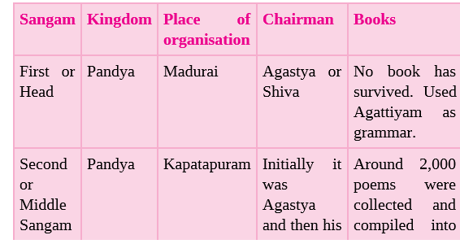
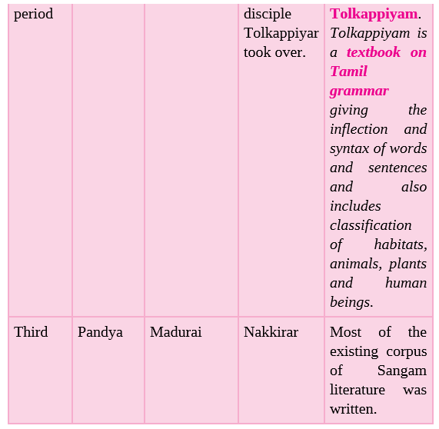

Slide 7
Sangam literature
It is also interesting to see that in the extant Sangam literature, around 30,000 lines of poetry, has been arranged in eight anthologies called Ettuttokoi. These were further divided into two groups; Patinenkil Kanakku (eighteen lower collections) and the second is Pattupattu (the ten songs).
The very famous and revered Tamil saint Thiruvallurar had contributed the ‘Kural’ to the Sangam literature. It has been now translated in several languages and is divided into three parts which discuss the epics, polity-governance and love.
Another famous female saint who contributed to Sangam literature is Avvaiyar.
Like the twin Sanskrit epics, Ramayana and Mahabharata, even Tamil has two major texts written in sixth century AD, i.e. Silappadikaram (story of an anklet) which was written by Ilango-Adigal. The second text is Manimekalai (the story of Manimekalai) written by Sattanar

Slide 8
Malayalam Literature
This language is usually spoken in Kerala and surrounding areas. Although linguists argue that the language originated in the 11th century, within a span of four hundred years, it had developed a corpus of literature rich enough to call it an independent language.
Two of the major Malayalam works of the medieval period are Kokasandisan and Bhasa Kautilya, which is a commentary on Arthashastra.
Another major literary work in Malayalam is Ramacharitam, an epic poem written by Cheeraman in 13th century.
Ezhuthachan, a strong proponent of Bhakti movement, is known as the father of Malayalam literature.

Slide 9
Kannada Literature
The Jain scholars made the first foray into the Kannada literature. The best example of a Jain-influenced text is Dharmanathapurana written by Madhava on the life of the fifteenth Tirthankara.
Several other scholars like Uritta Vilasa wrote Dharma Parikshe on the Jain teachings of this period.
One of the first recorded texts in Kannada is called Kavirajamarga, which was written by Nripatunga Amoghavarsha I, in the tenth century. He was also a very powerful Rashtrakuta king.

Slide 10
ratnatraya’
Kannada language has many great scholars but the ‘ratnatraya’ or ‘the three gems’ were unparalleled. The ratnatraya consisted of three poets called :-
Pampa –wrote Adipurana and Vïkramarjuna Vijaya (poetic work) and was attached to the court of Chalukya Arikesari.
Ponna ----has written a famous treatise, titled Shanti Purana.
Ranna-----has authored Ajitanatha Purano
These two poets were attached to the court of the Rashtrakuta king Krishna III

Slide 11
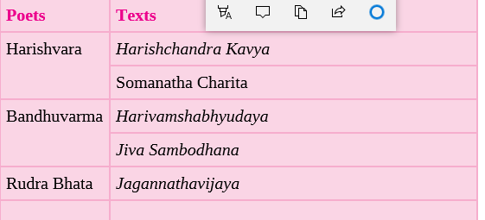

Other major texts in Kannada literature are:

Slide 12
MEDIEVAL LITERATURE
Several different trends emerged in the medieval period, which affected the languages, and dialects that emerged.
The major change was the emergence of Persian as the writing of the Delhi Sultanate and Mughal courts.
This period also sees the development of Hindi from the ancient apabhramsa language.

Slide 13
Persian
Although the roots of Persian language are as old as Sanskrit, it came to India with the coming of Turks and Mongols in the twelfth century.
It is during their rule that Persian became the mode of communication of the court. One of the finest Persian poets is Amir Khusrau Dehlavi (Amir Khusrau of Delhi). Apart from his Diwan (collection of poetry in Persian), he also wrote Nuh Sipihr and the Masnavi Duwal Rani Khizr Khan, that is a tragic love poem.

Slide 14
In the Delhi Sultanate, Zia-ud din Barani is amongst the top historians of that period and he wrote Tarikh-e-Firuz Shahi.
Another famous historian was Minhajus Siraj.
There are several travel accounts written by famous travellers like Ibn Batuta (Moroccan traveller) that explain the socio-political scenario of the period.

Slide 15
Mughal period
Literature in Persian shot up in the Mughal period.
Mughal emperor Babar wrote Tuzuk-I-Babari in Turkish, which is his autobiography and gives us important information about the Mughal conquest of India.
Another important work is Humayun-nama which gives an account of his life and struggles to get the throne, written by half-sister of Humayun, Gulbadan Begum.

Slide 16
The greatest emperor of this period was Akbar and Ain-e Akbari and Akbarnama written by his court historian Abul Fazl, are the best examples of literature of this period.
He ordered several translations of Sanskrit texts like Ramayana, Bhagwata Gita and several Upanishads into Persian.
Two major examples are the Mahabharata which when translated into Persian was called Razmnama.
One of highly illustrated works from this period is called Hamzanama, which depicts the story of the mythical Persian hero, Amir Hamza.

Slide 17
Malik Muhammad Jayasi also composed his Padmavat in this period.
Other major writers of this period include Badauni, who wrote on ethics of political rule and
Faizi who was considered a master of Persian poetry.
Several texts were produced in the period of Shah Jahan, especially about the emperor like the Shah Jahan-nama of Inayat Khan.
In Aurangzeb’s period, several satirists like Mir Jafar Zatalli wrote their Kulliyat (collection of verses).
Texts like Tabqat-i-Alamgiri give us a good idea about the period of eighteenth century.
Padshahnama was written by Abdul Hamid Lahori. It is about Shah Jahan.

Slide 18
Urdu
The linguists have debated that Urdu developed through the interaction of Persian and Hindi, especially in the barracks of the Turkish army.
Amir Khusrau also wrote several texts in Urdu, which was in its nascent stage in this period.
The language mostly follows the grammar of Hindi and the form and script of Persian. As it was used by the Bahamani state of Ahmedabad, Golconda, Bijapur and Berar, it was initially also called Dakkani (southern).

Slide 19
Urdu poets
One of the greatest Urdu poets is Mirza Ghalib who composed Diwan (collection of poetry) in Urdu.
Several other Urdu poets were Sauda, Dard and Mir Taqi Mir.
In the twentieth century, a major figure in Urdu literary writing was Iqbal who wrote Bang-i-Dara. He is famous for writing ‘Saare jahan se achcha’, which has become a celebrated nationalistic song.
Apart from the last emperors of the Mughal empire like Bahadur Shah Zafar, who also wrote in Urdu; the Nawabs of Awadh patronised several scholars who composed in Urdu.
In the twentieth century, it was given uplift by the moderniser Sir Sayyid Ahmad Khan who wrote several didactic and nationalist texts in Urdu and English.

Slide 20
Hindi
With the coming of the British, the focus of literature changed. This change occurred phenomenally in Hindi prose writing where there was a zest to go back to the classics and be inspired by Sanskrit. This zest was combined with the nationalistic fervour.
Bharatendu Harishchandra wrote his most famous drama Andher Nagari (City of Darkness) in 1850s and this became a major play, which has been reproduced several times.
Another very famous nationalist work is Bharat Durdasha.
Another major writer from this period is Mahavir Prasad Dwivedi after whom an entire phase of Hindi writing has been named

Slide 21
Hindi the national language
The movement to make Hindi the national language, which would link all regions, was spearheaded by Swami Dayanand. Although he wrote quite a lot in Gujarati, his most famous work in Hindi is Satyartha Prakash.
Several Hindi authors like Munshi Prem Chand, Surya Kant Tripathi ‘Nirala’, Maithili Sharan Gupt questioned the orthodoxies in the society.
Prem Chand wrote many anthologies in Hindi and Urdu and his famous works include Godan, Bade Bhhaiya, etc.
Other notable writers in Hindi include Sumitranandan Pant, Ramdhari Singh ‘Dinkar’ and Harivansha Rai Bachchan who wrote Madhushala.
One of the most famous female writers of Hindi in the twentieth century was Mahadevi Verma. She was the recipient of Padma Vibhushan in Hindi because of her writing and how it highlighted the condition of women in the society.

Slide 22
Bengali literature.
After Hindi, the next significant literature was the on
Raja Ram Mohan Roy who wrote in Bengali besides English that gave impetus to Bengali literature. Ishwar Chandra Vidyasagar (1820-91) and Akshay Kumar Dutta (1820- 86) were two other writers of this early period.
In addition to these, Bankim Chandra Chatterji (l834-94), Sharat Chandra Chatterji (l876-1938), and R.C. Dutta, a noted historian and a prose writer, all contributed to the making of Bengali literature.
But the most important name that influenced the whole of India was that of Rabindra Nath Tagore (1861-1941). Novels, dramas, short stories, criticism, music and essays, all flowed from his pen. He won the Nobel Prize for literature in 1913 for his Geetanjali. e that developed in Bengal.

Slide 23
Assamese
Assamese - Like Bengali, Assamese also developed in response to the Bhakti movement.
Shankardeva who introduced Vaishnavism in Assam helped in the growth of Assamese poetry.
Even the Puranas were translated in Assamese.
The earliest Assamese literature consisted of buranjis (court chronicles).
Shankardev has left several devotional poems, which people song with rapturous pleasure, but it was only after 1827 that more interest was shown in producing Assamese literature. Two names, Lakshmi Nath Bezbarua and Padmanaba Gohain Barua cannot be forgotten.

Slide 24
Oriya literature
From Orissa, a couple of names are worth mentioning and these are Fakirmohan Senapati and Radha Nath Ray, whose writings deserve considerable attention in the history of Oriya literature.
The works of Upendra Bhanja (1670 - 1720) were important as they ushered a new period of Oriya literature.
In Orissa the works of Saraladasa are regarded as the first works of Oriya literature

